Slide 1
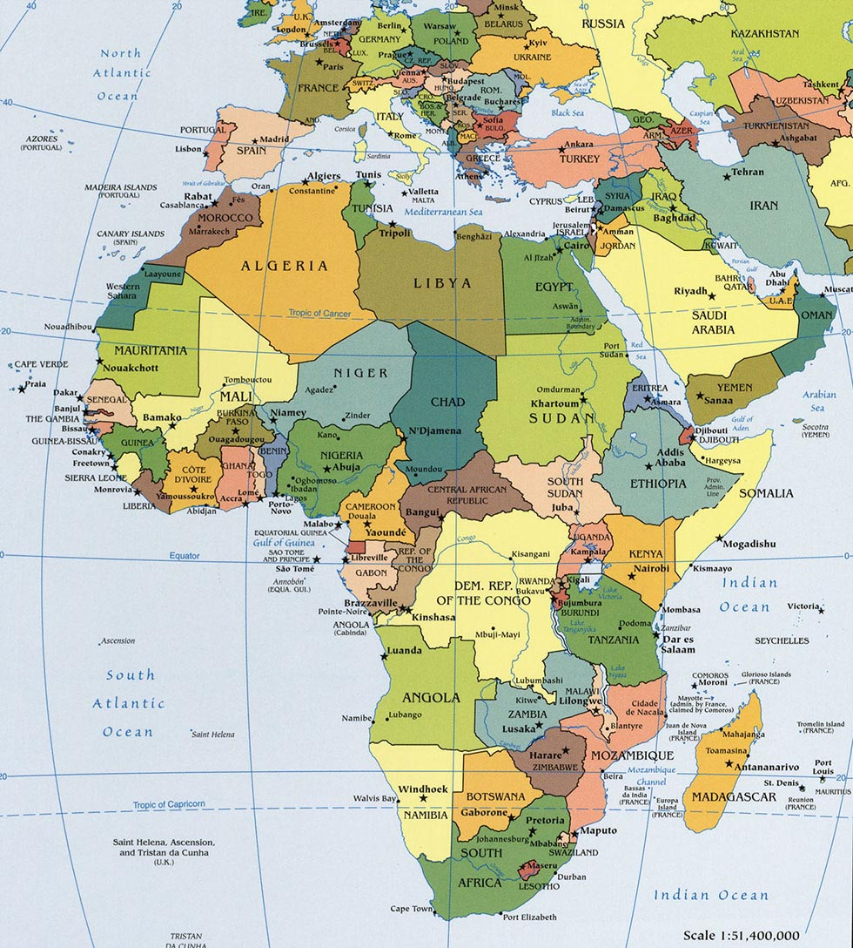
Africa:
What the Heck, Bro?

Slide 2
Africa’s Present Condition
The world’s neediest geographic realm
Income level
Diet
Infant mortality rate
Life expectancy
Literacy
Disease
Corruption
Technology

Slide 3
WHY?
Brainstorm

Slide 4
7 KEY REASONS

Slide 5
1. Climate Change
Wisconsian Glaciation replaced by Holocene Epoch (12,000 years ago)
Rainforests dry out, move towards poles
Sahara emerges
Huge barrier!
Subsaharan isolation

Slide 6
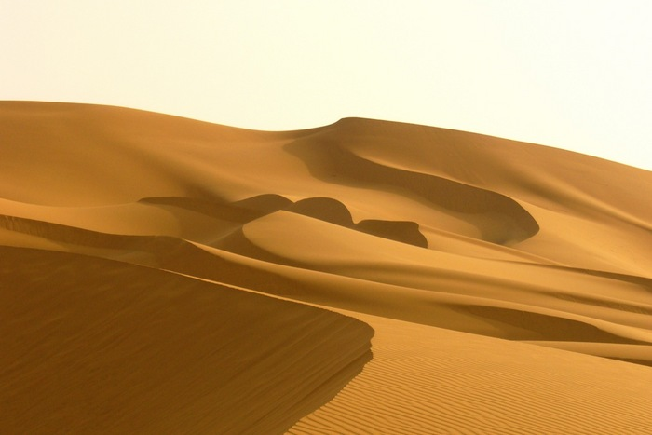
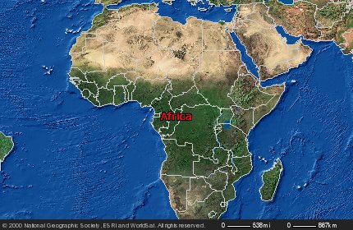
US: 3,718,711 mi² Sahara: 3,500,000 mi²

Slide 7
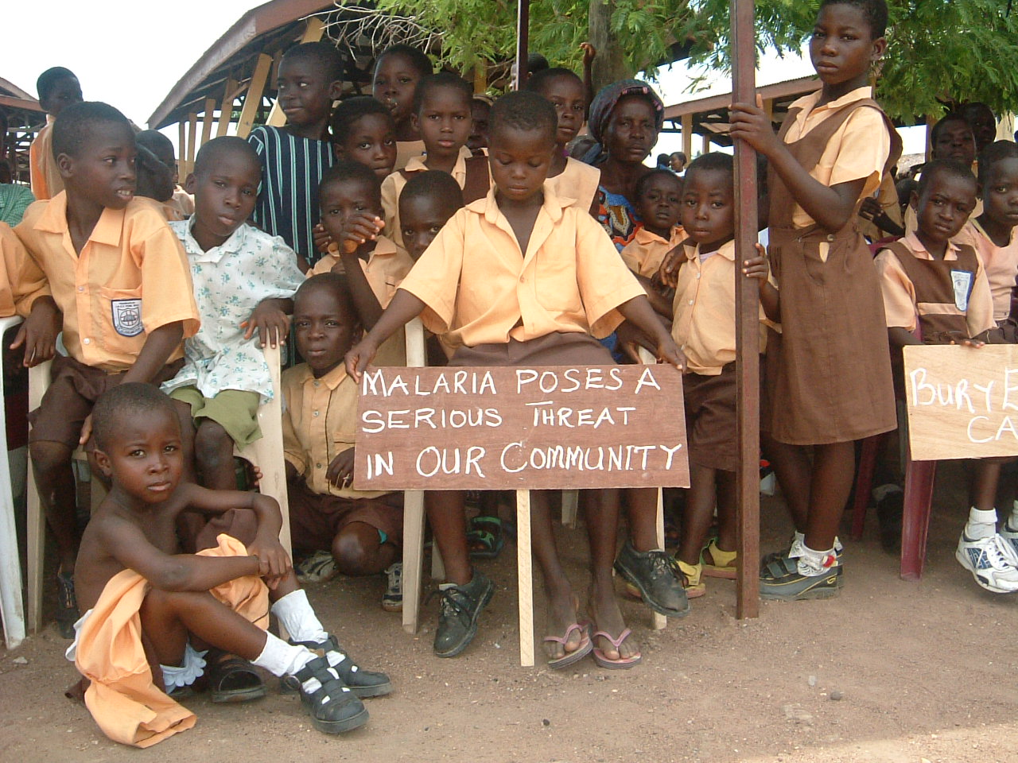
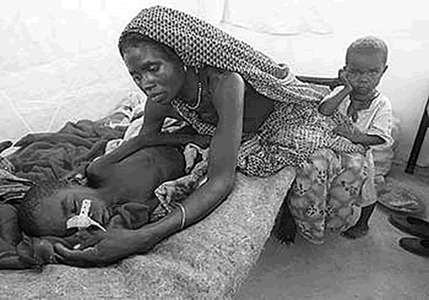
2. Ecology
Problems with cultivation
Plant/animal domestication elsewhere, NOT HERE
Poor nutrition → Diseases
Heat/humidity = hotbed
Malaria
Yellow fever

Slide 8
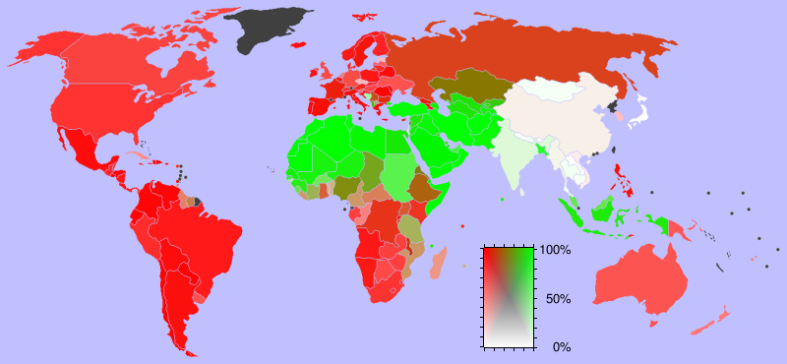
3. Religion
Yet another barrier
“Islamization” – 14th century
Pilgrimages through Africa across Red Sea
“Christianization” – 15th-17th centuries
European explorers meet African tribes
“Northern vs. Subsaharan” reinforced, desert AND religion
** CONSTANT CONFLICT**

Slide 9
4. Slave Trade and Depopulization
European exploration & slave trade
17th century numbers:
World population: 650 million
Subsaharan Africa: 90 million
Slaves from Africa: 15 million
1/6 of population GONE!
Effects of slave trade:
Entire cities wiped out
African vs. African
Children orphaned
Crops unharvested
General breakdown of social order

Slide 10
5. Colonialism
Exploration of interior Africa (17-19th century)
Conflicting claims
Berlin Conference (1885)
Ethnic groups split
Enemies combined
Europeans’ goal: acquire resources
Different approaches
British: friendly
French and Portuguese: not so much
Germans and Belgians: not at all
King Leopold and “Congo Free State”: 10-20 million murdered
Lasting impact: ethnic tension

Slide 11
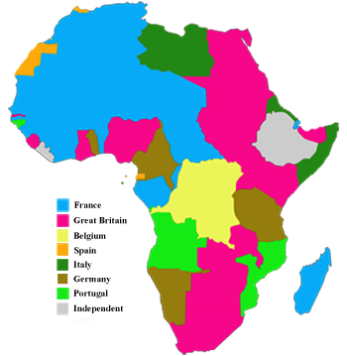

Slide 12
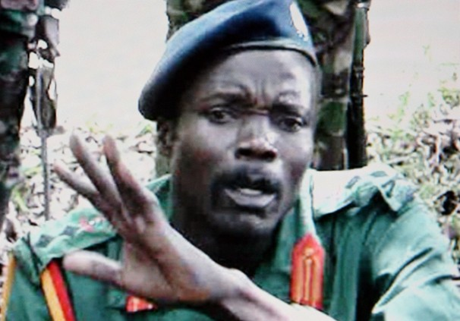
6. The Cold War
World powers battling eachother
Too busy for Africa
Colonial era ends in 1957
Problem: from colony to state too fast!
Struggle for power
Nations (tribes) within states fight
Hundreds of thousands of ordinary Africans die from war, starvation, dislocation, etc
Bad guys take over

Slide 13
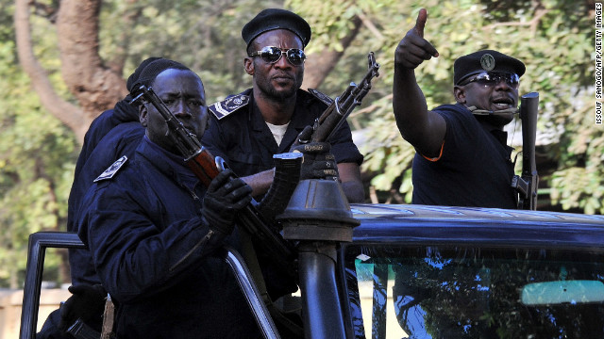
7. Terrorism
Bad guys in charge = freedom for other bad guys
Desperation = people to recruit
Mali
Algeria
Nigeria
Somalia

Slide 14
Questions to consider
How much of Africa’s problems are Africa’s fault?
Is there hope for Africa to get safer/healthier/happier?
What should America’s role be in helping Africa?
How are ordinary Africans’ lives affected?

Slide 15
3. . . 2. . . 1. . .
GENOCIDE!

